Slide 1
Soft Processor Design
Lucas Donovan

Slide 2
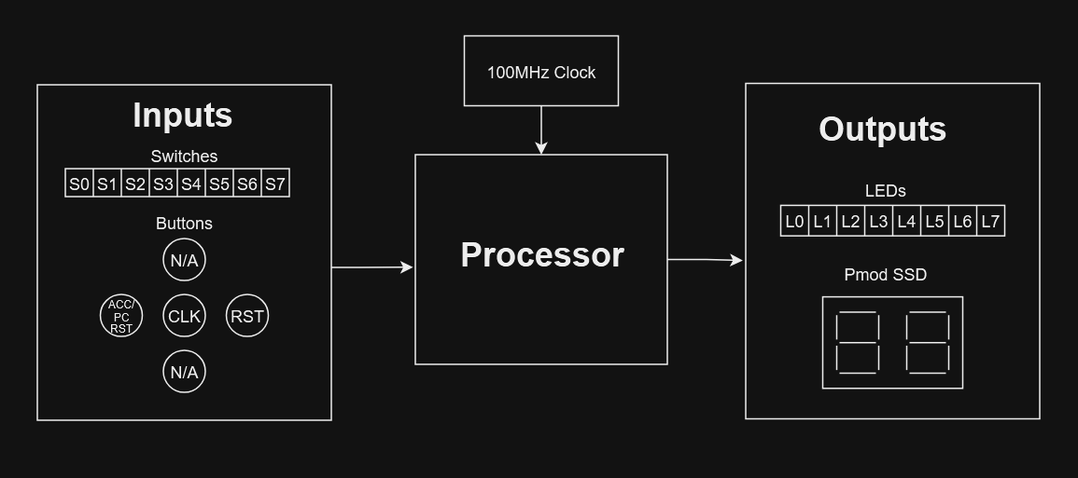
System Overview
Zedboard
Inputs
8 switches
3 buttons
System Clock
Outputs
8 LEDs
Pmod seven segment display module (2 digits)

Slide 3
Registers
Program Counter (4 bits)
Accumulator (4 bits)
Instruction Register (8 bits)
General Purpose Registers (16 x 4 bits)
reg [3:0] R [0:15];
2 Condition Codes (1 bit each)
Zero
Carry

Slide 4
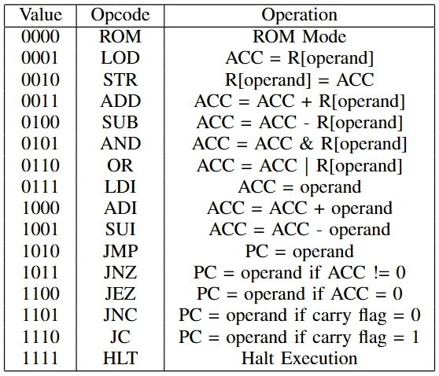
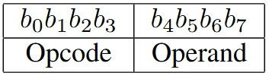
Instruction Set
Format
16 total opcodes
6 register direct instructions
3 immediate instructions
5 branching instructions
ROM mode
Halt instruction

Slide 5
ROM Mode
When the opcode is 0, the processor executes the instructions in the ROM.
ROM input is the PC, output is the instruction to run.
module Instruction_ROM (
input [3:0] pc,
output reg [7:0] instr
);

Slide 6
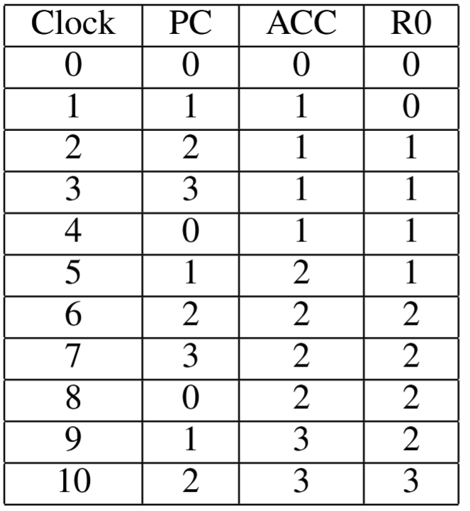
Example Program - Counter
0001_0000; // LOD 0 - ACC = R0
1000_0001; // ADI 1 - ACC = ACC + 1
0010_0000; // STR 0 - R0 = ACC
1011_0000; // JNZ 0 - PC = 0
if ACC != 0
1111_1111; // HLT F - Halt Execution
The first instruction isn’t necessary, but it when removed the program will reset completely even if the registers aren’t reset, whereas with it will keep it’s value.

Slide 7
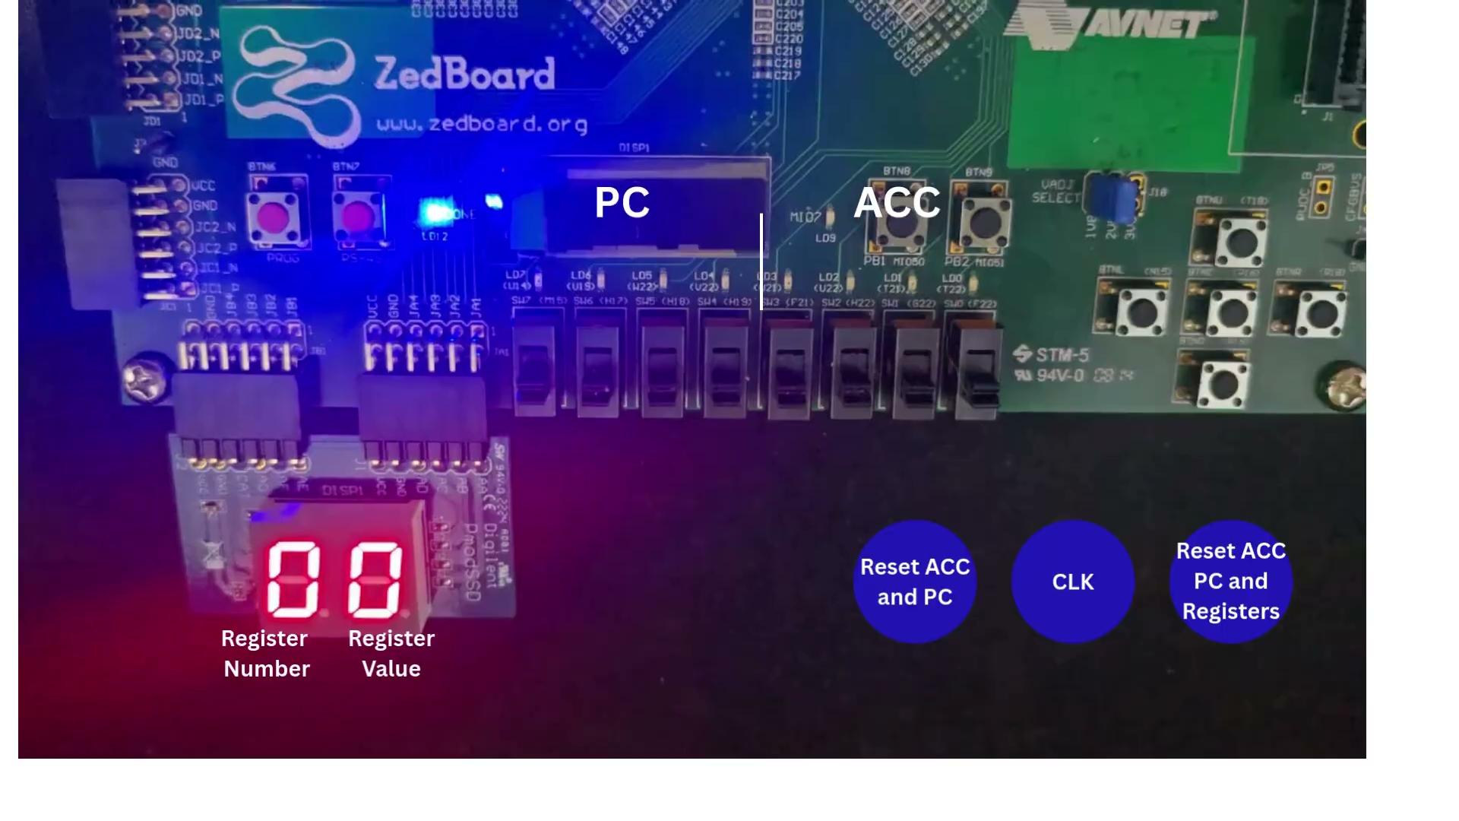
Demonstration

